Slide 1
Alternative Approaches for Generating Bodies of Grammar Rules
Gabriel Infante-Lopez and Maarten de Rijke. 2004.
Yucong He
20240711

Slide 2
Preliminaries

Slide 3
Language Model
Input S_{i}
↓
output S_{o}
Eg.
I love _________________
↓
I love machine learning
Notes:
语言模型就是用来计算一个句子的概率的模型，也就是判断一句话是否合理的概率

Slide 4



N-gram
Conditional Probability
Markov chain
N = 0
N = 1
N = 2
Notes:
这个方法会生成非常多冗余的关系

Slide 5
CFG
Probabilistic
Context-free Grammar (CFG)
G is a 4-tuple ( V_{N} , V_{T} , S , R )
V_{N}: set of non-terminals { S , Adj , Noun }
V_{T}: set of terminals { ball , big , red }
S: starting symbols, either terminals or non-terminals
R: set of rewrite rules { S → Adj + Noun ; Adj → big | Adj → red ; Noun → ball }
1
S
Adj + Noun
Big + Noun
Big + ball
0.5
0.5
1
Notes:
会有很多歧义的问题

Slide 6
Probabilistic Constrained W-grammar
(PCW-grammar)

Slide 7


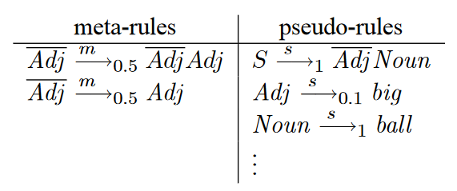



Probabilistic Constrained W-Grammar (PCW grammar)
part of speech (POS)
Notes:
它将词性的概念引入了正则语言中
原来的正则语言
PCW的样子
使用元规则来实例化伪规则主体中的所有变量

Slide 8
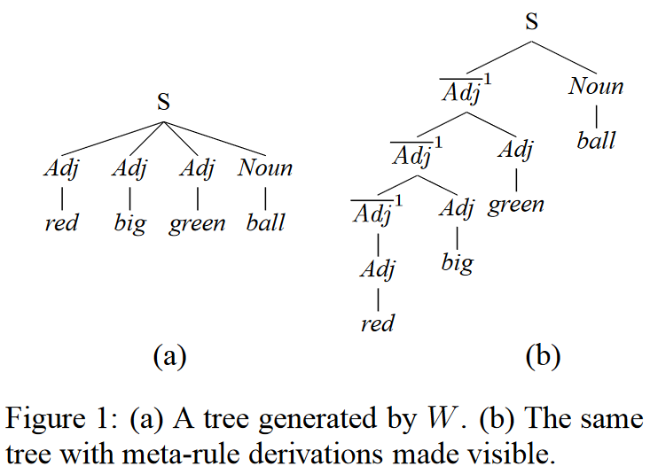
Probabilistic Constrained W-Grammar (PCW grammar)
Trees for this particular grammar are flat, with a main node S and all the adjectives in it as daughters.
Notes:
PCW单独将词性提出来作为meta-rules，并且在构造树的时候将其隐藏

Slide 9
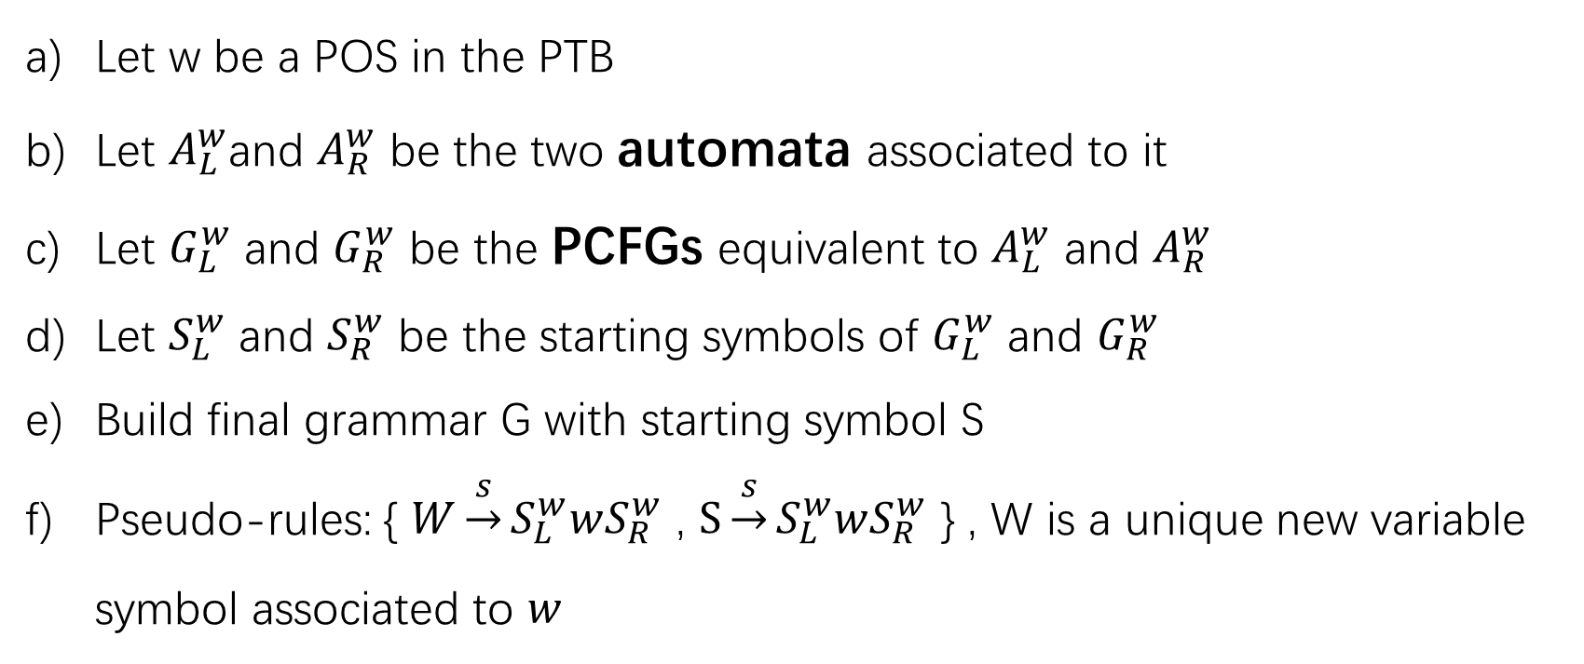
From Automata to Grammars
Let w be a POS in the PTB
Let $A_{L}^{w}$and $A_{R}^{w}$ be the two automata associated to it
Let $G_{L}^{w}$ and $G_{R}^{w}$ be the PCFGs equivalent to $A_{L}^{w}$ and $A_{R}^{w}$
Let $S_{L}^{w}$ and $S_{R}^{w}$ be the starting symbols of $G_{L}^{w}$ and $G_{R}^{w}$
Build final grammar G with starting symbol S
Pseudo-rules: { $W\underset{→}{s}S_{L}^{w}wS_{R}^{w}$ , $S\underset{→}{s}S_{L}^{w}wS_{R}^{w}$ } , W is a unique new variable symbol associated to $w$

Slide 10
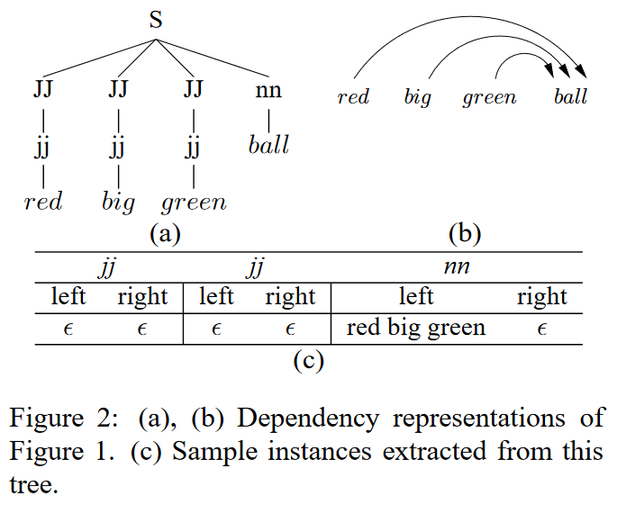
Learning Probabilistic Automata
Building the Sample Sets
① Eliminate all word information, leaving only POS tags
② From the tree we generate a sample set with all right sequences of dependents { , , } , and another with all left sequences { , , red big green}

Slide 11
Learning Probabilistic Automata
Learning:
N-gram (N=2)
It adds an arc between states aβ and βb, if the sequence aβb appears in the training set.
The probability assigned to the arc (aβ, βb) is proportional to the number of times the sequence aβb appears in the training set.

Slide 12

Learning Probabilistic Automata
2. Minimum Discrimination Information (MDI) algorithm
Builds an automaton that only accepts the strings in the sample set by merging common prefixes, thus producing a tree-shaped automaton
The MDI algorithm traverses the lattice of all possible partitions for this general automaton, attempting to merge states that satisfy a trade-off that can be specified by the user.
S
S
Adj
Adj
Adj
blue
red
blue
red
S
A₁ is a temporary solution of the algorithm
A₂ is a tentative new solution derived from A₁.
Adj
∆(A₁, A₂) = D(A₀||A₂) − D(A₀||A₁)
blue
red
D(A₀||A_{i}) is the Kullback-Leibler divergence or relative entropy
Notes:
通常使用的方法是N-grams
但是这个方法n-grams are incapable of capturing long-distance relations between words
效率非常低

Slide 13


Evaluate the Quality
1. test sample perplexity (PP)
$P(x)$is the probability assigned to the string x by the automata
2. the number of missed samples (MS)
A string in the test sample that the automaton failed to accept.
3. the size of the automata
NumEdges: the number of edges
NumStates: the number of states
Notes:
困惑度越高越不可靠
单独计算MS的数量，并在不考虑MS的情况下计算PP。这种选择导致PP的值更准确，而且MS的值为我们提供了关于自动机泛化能力的信息：MS值越低，自动机的泛化能力越大。

Slide 14
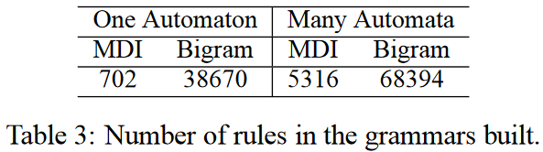
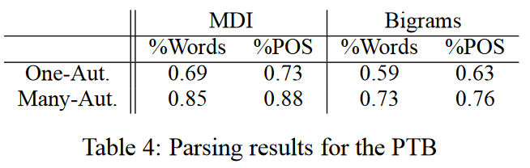
Experiment

